Slide 1
Be Proactive
Be in Charge of Yourself!

Slide 2
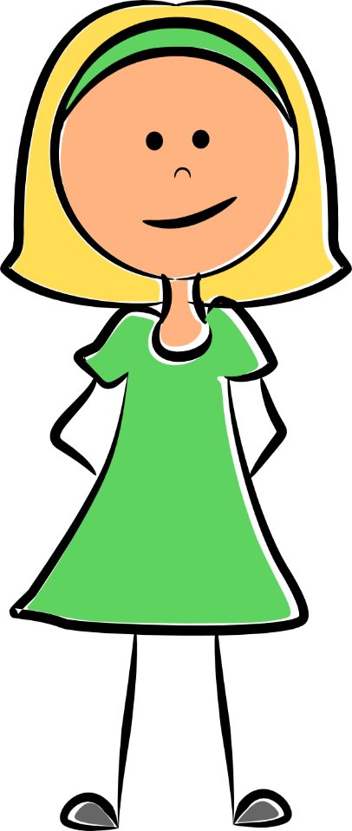
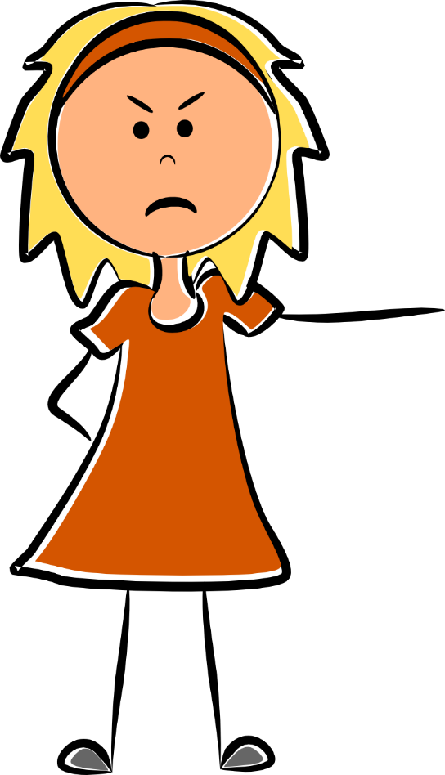
Proactive vs. Reactive
Proactive people choose their actions and attitudes.
Reactive people let others decide how they feel & act.
I can choose to be nice, even when others are unkind to me.
She made me angry! I couldn’t help being mean!

Slide 3
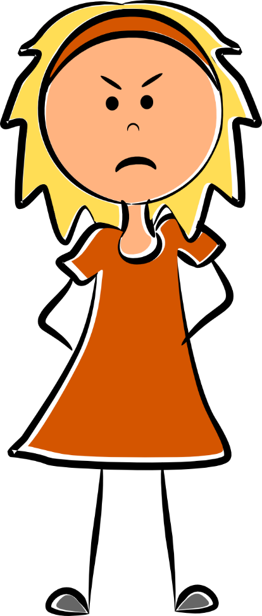
Proactive vs. Reactive
When proactive people see a problem, they take charge & fix it.
When reactive people see a problem, they wait for someone else to fix it.
Someone left books on the ground. I’ll clean them up so they are out of the way.
I wish someone would clean up these books! They’re in my way!

Slide 4
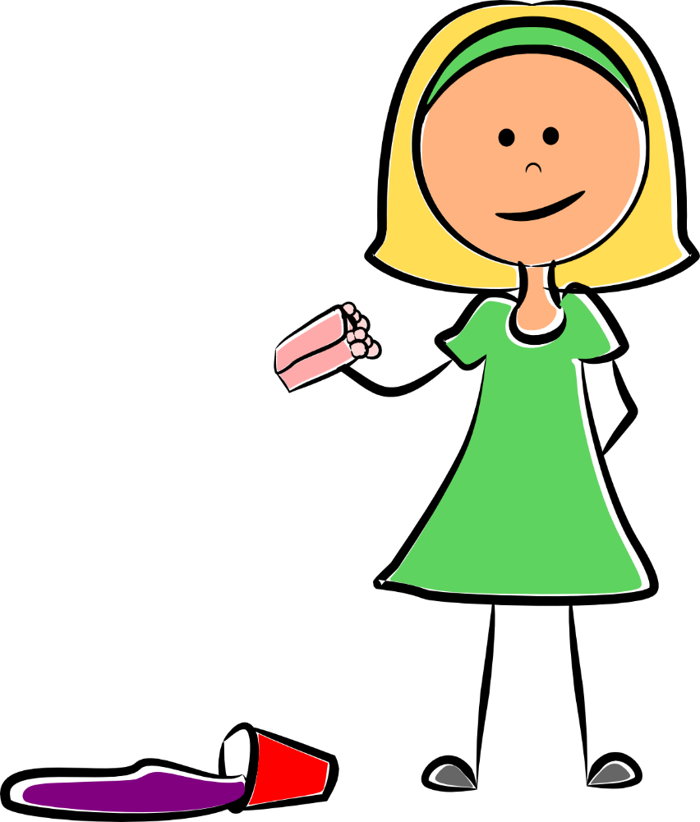
Proactive vs. Reactive
Proactive people admit when they’re wrong or have made a mistake.
Reactive people blame other people for their actions & mistakes.
It’s not my fault! She bumped into me. She should clean it up!
I’m sorry for spilling my juice. I’ll clean it up.

Slide 5
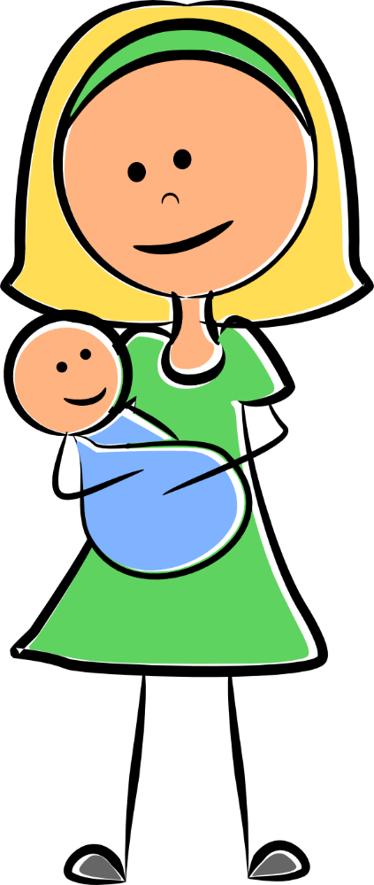
Proactive vs. Reactive
Proactive people do the right thing even if no one else is watching.
Reactive people only do the right thing if they know they’ll get a reward.
I’m not going to help him unless I get some kind of reward!
I’ll play with my baby brother to keep him from crying, even though no one is looking.

Slide 6
Reactive People
Reactive people are like a rowboat with no oars that goes wherever the wind and waves take it.
They aren’t in control and go wherever life takes them.
They let other people decide how they feel and what they do.
And if they never take control of their emotions and actions….
When the storms come, they might sink!

Slide 7
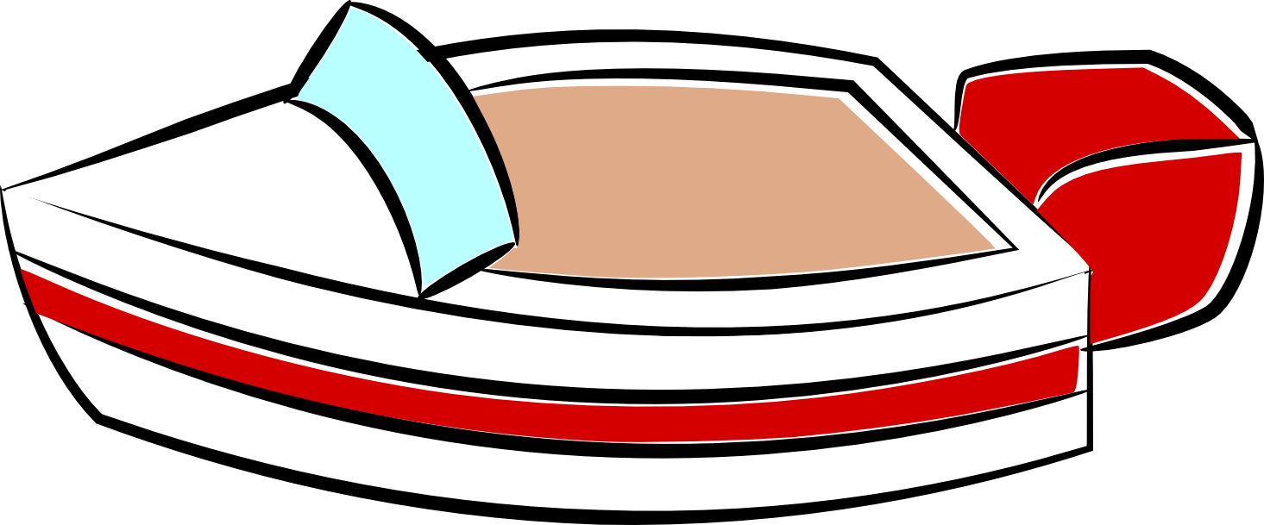
Proactive People
Proactive people are like a motorboat that can steer and control where it goes.
They take charge of where they’re going in life.
When difficult things happen, they choose their attitude and how they act.
And since they take charge of their emotions and actions….
When the storms come, they don’t sink!

Slide 8
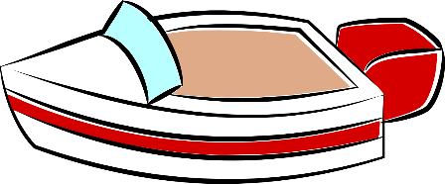
Do you know the difference?
Do you know the difference between proactive and reactive choices?
In the following stories decide if the person is making a
proactive
choice or a
reactive choice.
Then click on your answer to see if you’re right!
Proactive
Reactive

Slide 9
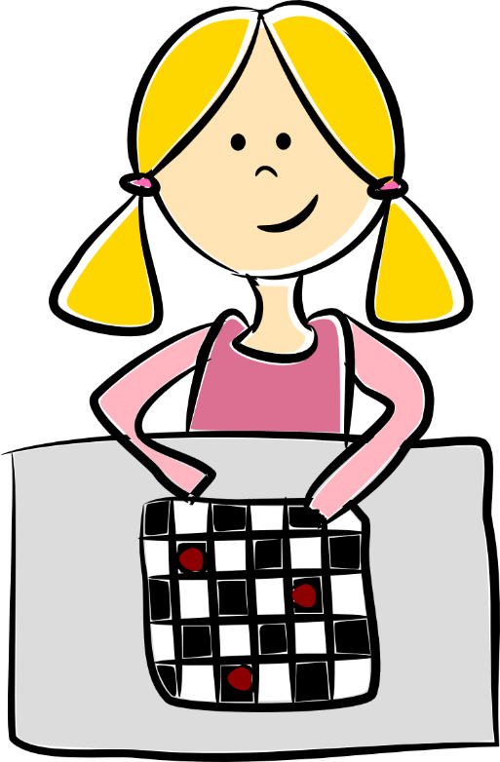
This was a proactive choice!
Hannah made a proactive choice by being polite even though she felt sad. She choose how to act instead of just reacting to how she felt.
Hannah lost a game of checkers. Even though she was sad, she smiled and said, “Good game!” Was she being proactive or reactive?
Proactive
Reactive

Slide 10
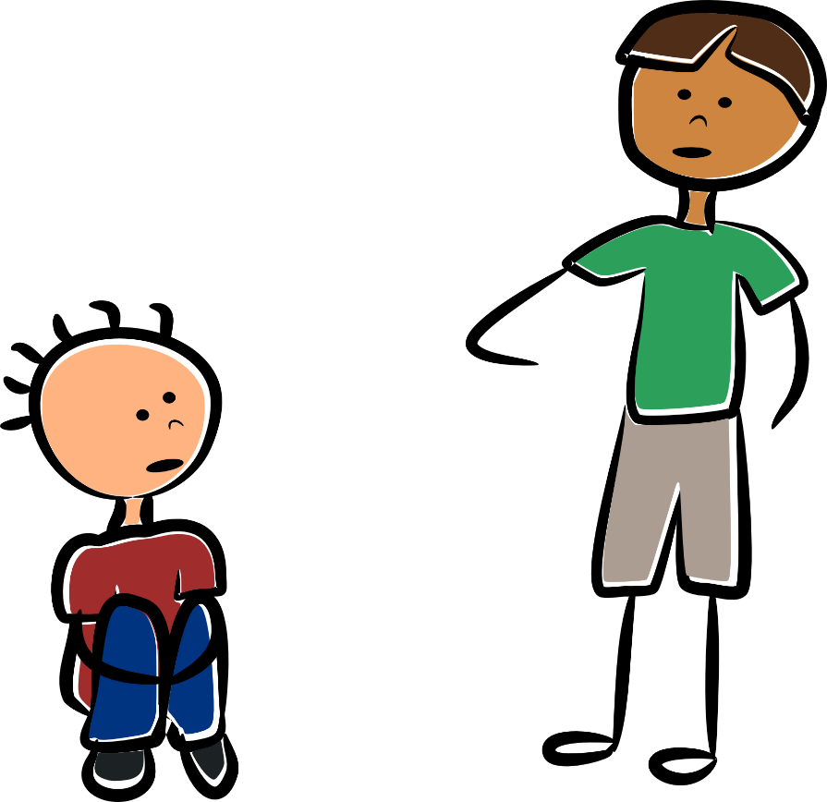
This was a proactive choice!
Juan saw a boy who looked sad sitting alone during recess. He asked the boy if he wanted to play with him. Was he being proactive or reactive ?
When Juan asked the boy to play, he showed he was proactive by seeing a problem and trying to fix it.
Proactive
Reactive

Slide 11
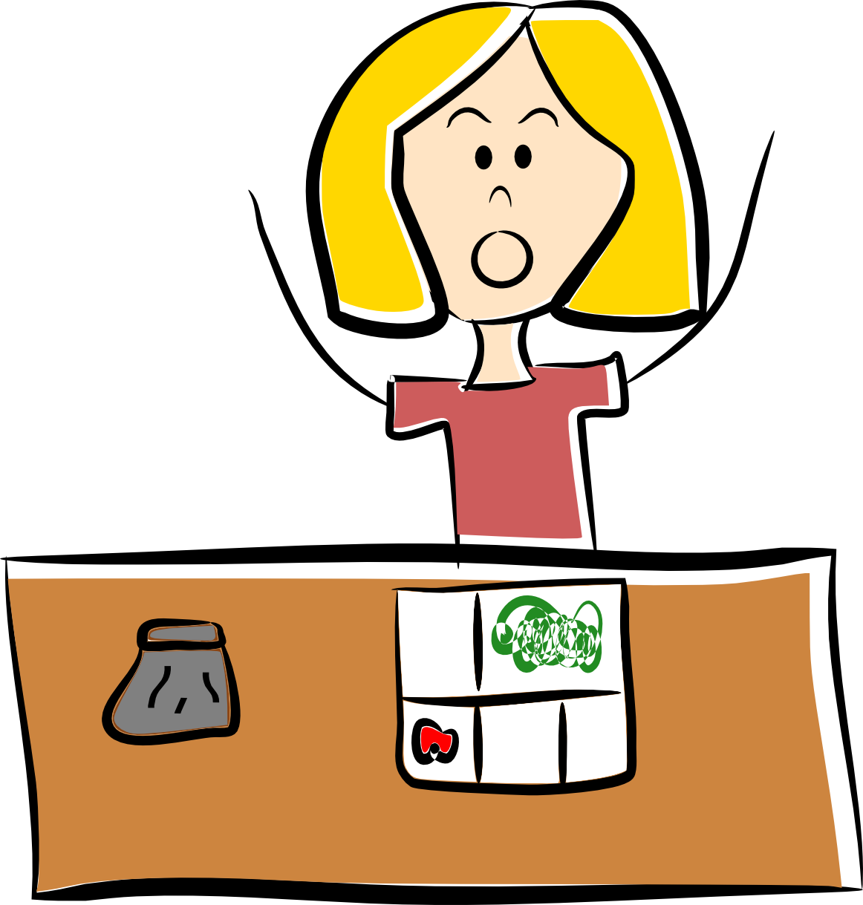
This was a
reactive choice.
What would be a proactive choice?
The teacher asked Lily to pick up the bag next to her before she could go out to recess after lunch. Lily said, “But that isn’t mine!” and wouldn’t pick it up. Was she being proactive or reactive?
Lily could be proactive by cleaning up the mess without anyone having to ask her.
Proactive
Reactive

Slide 12
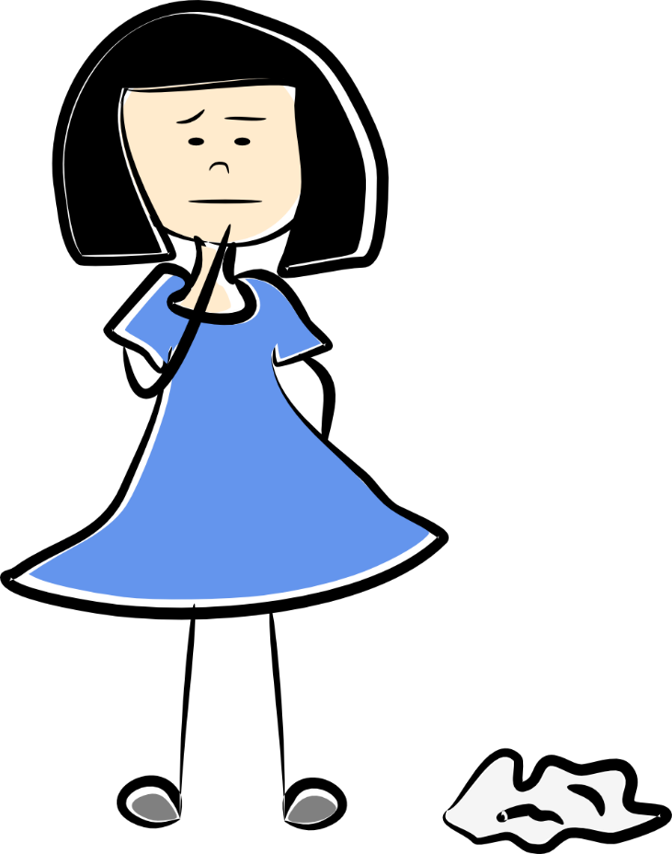
This was a proactive choice!
Sarah saw a piece of trash on the ground. She threw it away even though no one was looking. Was she being proactive or reactive?
Sarah made a proactive choice by seeing a problem and fixing it instead of waiting for someone else to fix it.
Proactive
Reactive

Slide 13
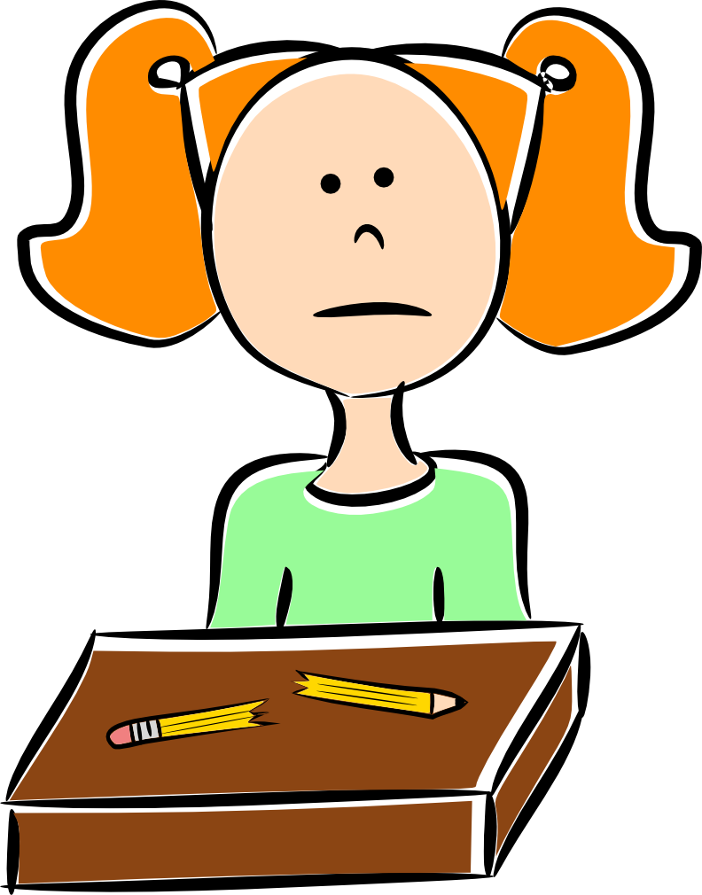
This was a
reactive choice.
What would be a proactive choice?
Megan could be proactive by sharpening her pencil, getting a new one, or asking the teacher for a pencil instead of waiting for someone to notice.
Megan broke her pencil. She waited until the teacher noticed and got her a new one. She missed half her assignment while waiting. Was she being proactive or reactive?
Proactive
Reactive

Slide 14
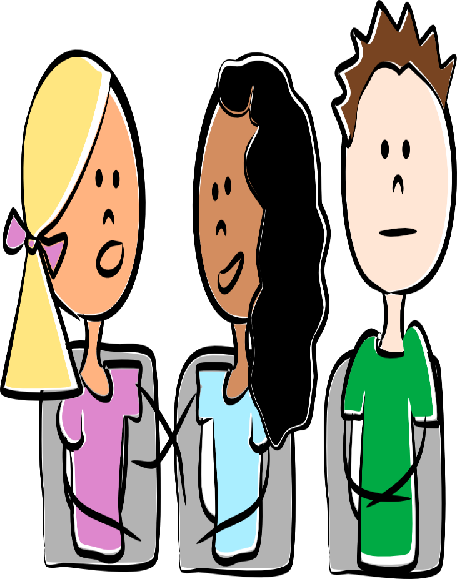
This was a proactive choice!
Eric sat quietly during the assembly even though the people next to him were talking. Was he being proactive or reactive?
Eric made a proactive choice by choosing to be in control of his actions and stay quiet even though he may have wanted to talk like the other children.
Proactive
Reactive

Slide 15
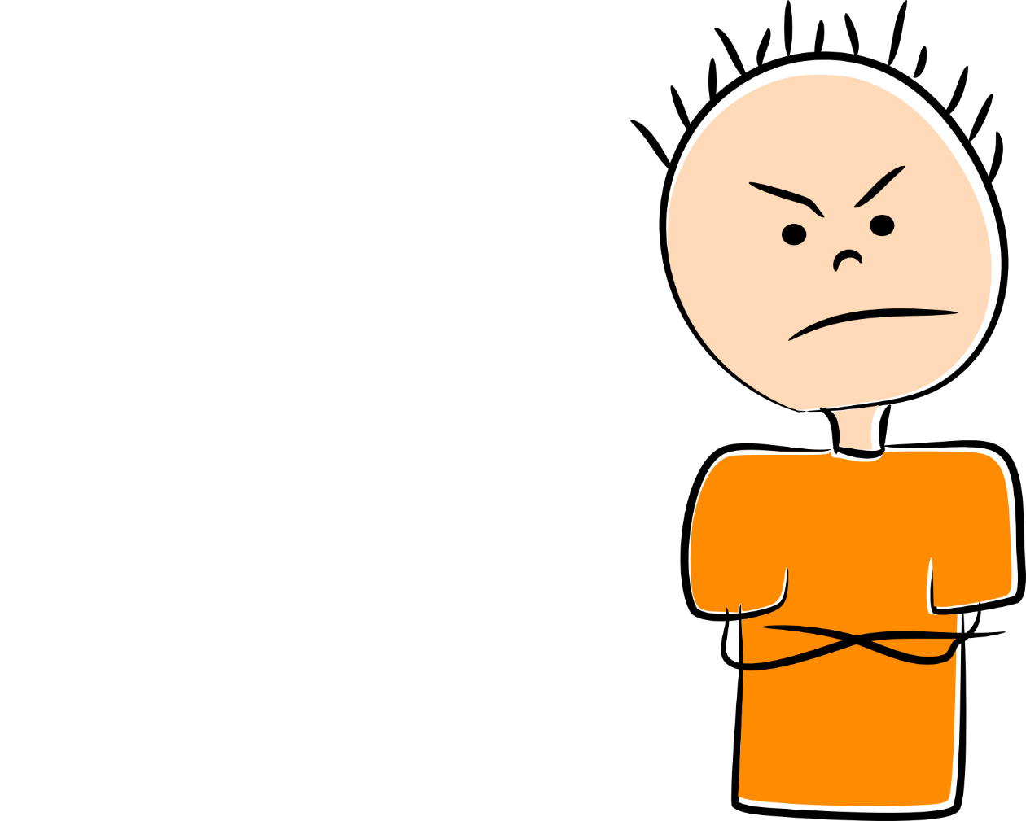
This was a
reactive choice.
What would be a proactive choice?
Someone cut in front of Jack in line for lunch. Jack pushed him and called him a mean name. Was he being reactive or proactive?
Jack could be proactive by choosing to stay calm and not say mean things even if he feels mad.
Proactive
Reactive

Slide 16
This was a
reactive choice.
What would be a proactive choice?
James could be proactive by admitting that he forgot his homework and coming up with a plan to remember it the next day.
James didn’t bring his homework to school. When the teacher asked him where it was he said his mom forgot to put it in his backpack. Was he being proactive or reactive?
Proactive
Reactive

Slide 17
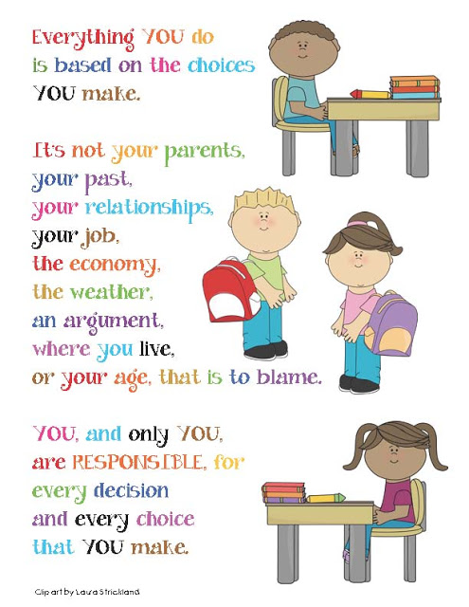
I have an “I CAN” attitude!

