Slide 1
Battle of the Books comes back to Sandy Miller ES!!

Slide 2
Do you LOVE Reading? Do you remember little details from the books you have read? Do you like to play games? Do you like being part of a team? THEN BATTLE OF THE BOOKS MIGHT JUST BE FOR YOU!

Slide 3
HERE IS HOW IT WORKS… This event is open to all fourth and fifth grade students. It is a team event with each team consisting of four members only. Your team must read the 8 designated books. All of the books are in the School Library, County Libraries or they can be purchased.

Slide 4
The Competition….
We will hold Jeopardy-Style Battles for points. After two rounds, the four teams with the highest combined points will move to the semi-final round. The two winning teams will advance to the FINAL BATTLE. The winning team will go on to represent Sandy Miller Elementary School at the regional competition for CCSD.

Slide 5
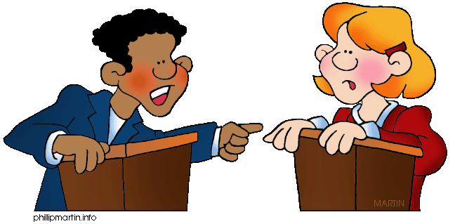
Battle of the Books
2018-2019
Start reading now!

Slide 6
Maxi’s Secrets:
(Or, What You Can Learn from a Dog) by Lynn Plourde
Timminy knows that moving to a new town just in time to start middle school when you are perfect bully bait is less than ideal. But he gets a great consolation prize in Maxi—a gentle giant of a dog who the family quickly discovers is deaf. Timminy is determined to do all he can to help Maxi—after all, his parents didn't return him because he was a runt. But when the going gets rough for Timminy, who spends a little too much time getting shoved into lockers at school, Maxi ends up being the one to help him—along with their neighbor, Abby, who doesn’t let her blindness define her and bristles at Timminy’s “poor-me” attitude. It turns out there’s more to everyone than what’s on the surface, whether it comes to Abby, Maxi, or even Timminy himself.

Slide 7
The Honest Truth
By Dan Gemeinhart
It's never too late for the adventure of a lifetime.
In all the ways that matter, Mark is a normal kid. He's got a dog named Beau and a best friend, Jessie. He likes to take photos and write haiku poems in his notebook. He dreams of climbing a mountain one day.
But in one important way, Mark is not like other kids at all. Mark is sick. The kind of sick that means hospitals. And treatments. The kind of sick some people never get better from.
So Mark runs away. He leaves home with his camera, his notebook, his dog, and a plan. A plan to reach the top of Mount Rainier. Even if it's the last thing he ever does.

Slide 8
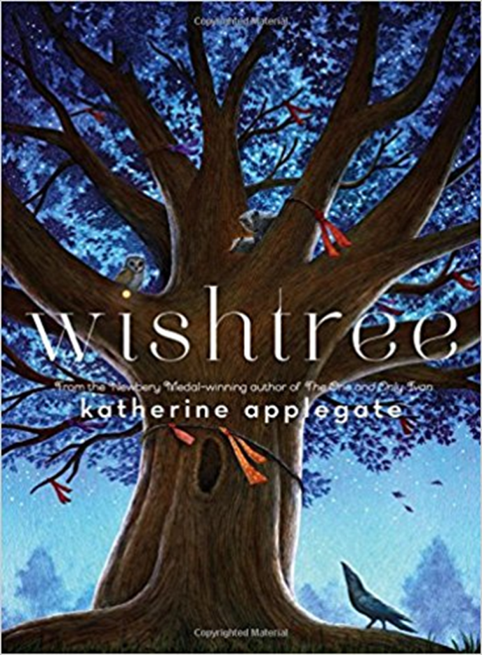
Wishtree
By Katherine Applegate
Trees can't tell jokes, but they can certainly tell stories. . . .
Red is an oak tree who is many rings old. Red is the neighborhood "wishtree"―people write their wishes on pieces of cloth and tie them to Red's branches. Along with a crow named Bongo and other animals who seek refuge in Red's hollows, this wishtree watches over the neighborhood.
You might say Red has seen it all.
Until a new family moves in. Not everyone is welcoming, and Red's experience as a wishtree is more important than ever.
Funny, deep, warm, and nuanced, this is Katherine Applegate at her very best―writing from the heart, and from a completely unexpected point of view.

Slide 9
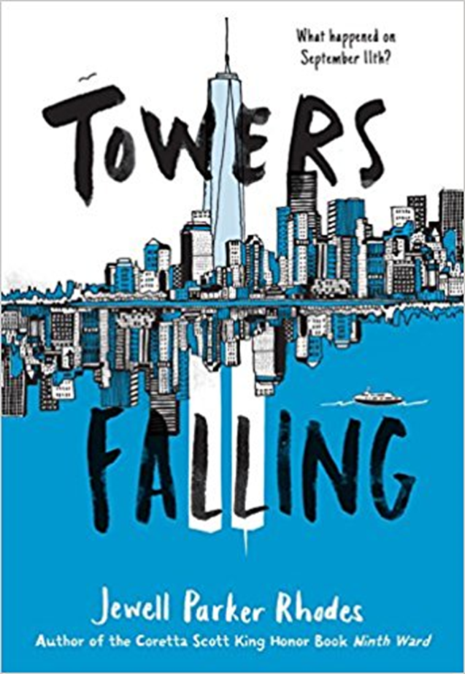
Towers Falling
By Jewell Parker Rhodes
When her fifth-grade teacher hints that a series of lessons about home and community will culminate with one big answer about two tall towers once visible outside their classroom window, Dèja can't help but feel confused. She sets off on a journey of discovery, with new friends Ben and Sabeen by her side. But just as she gets closer to answering big questions about who she is, what America means, and how communities can grow (and heal), she uncovers new questions, too. Like, why does Pop get so angry when she brings up anything about the towers?

Slide 10
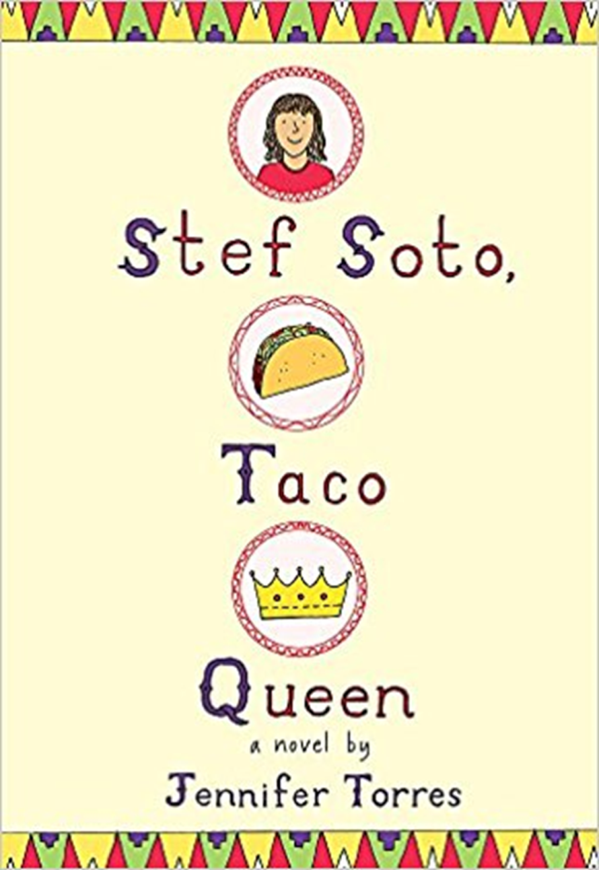
Stef Soto, Taco Queen
By Jennifer Torres
Estefania "Stef" Soto is itching to shake off the onion-and-cilantro embrace of Tia Perla, her family's taco truck. She wants nothing more than for Papi to get a normal job and for Tia Perla to be a distant memory. Then maybe everyone at school will stop seeing her as the Taco Queen.
But when her family's livelihood is threatened, and it looks like her wish will finally come true, Stef surprises everyone (including herself) by becoming the truck's unlikely champion. In this fun and heartfelt novel, Stef will discover what matters most and ultimately embrace an identity that even includes old Tia Perla.

Slide 11
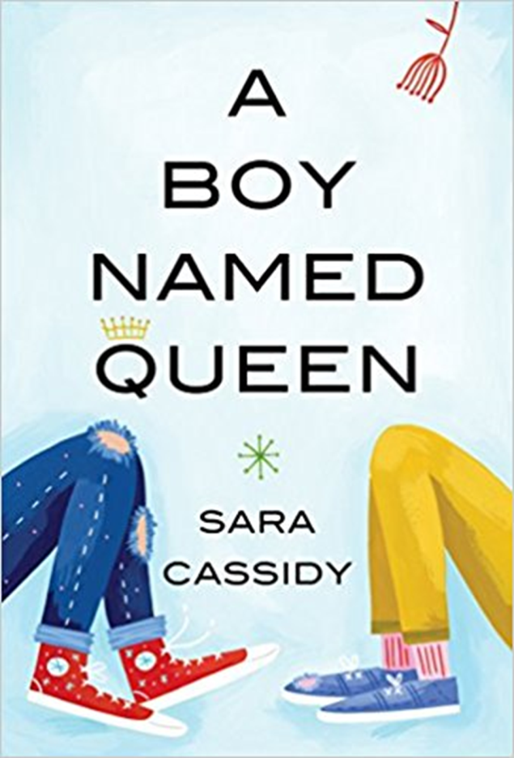
A Boy Named Queen
By Sara Cassidy
Evelyn is both aghast and fascinated when a new boy comes to grade five and tells everyone his name is Queen. Queen wears shiny gym shorts and wants to organize a chess/environment club. His father plays weird loud music and has tattoos.
How will the class react? How will Evelyn?
Evelyn is an only child with a strict routine and an even stricter mother. And yet in her quiet way she notices things. She takes particular notice of this boy named Queen. The way the bullies don’t seem to faze him. The way he seems to live by his own rules. When it turns out that they take the same route home from school, Evelyn and Queen become friends, almost against Evelyn’s better judgment. She even finds Queen irritating at times. Why doesn’t he just shut up and stop attracting so much attention to himself?

Slide 12
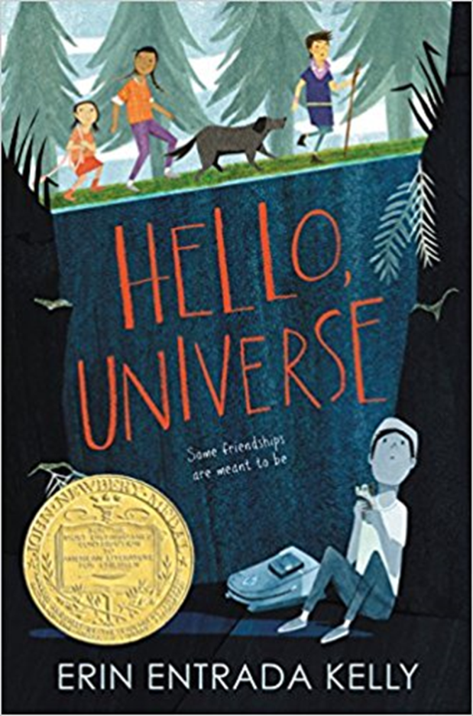
Hello, Universe
By Erin Entrada Kelly
Told from four intertwining points of view—two boys and two girls—the novel celebrates bravery, being different, and finding your inner bayani (hero). “Readers will be instantly engrossed in this relatable neighborhood adventure and its eclectic cast of misfits.”—Booklist
In one day, four lives weave together in unexpected ways. Virgil Salinas is shy and kindhearted and feels out of place in his crazy-about-sports family. Valencia Somerset, who is deaf, is smart, brave, and secretly lonely, and she loves everything about nature. Kaori Tanaka is a self-proclaimed psychic, whose little sister, Gen, is always following her around. And Chet Bullens wishes the weird kids would just stop being so different so he can concentrate on basketball.
They aren’t friends, at least not until Chet pulls a prank that traps Virgil and his pet guinea pig at the bottom of a well. This disaster leads Kaori, Gen, and Valencia on an epic quest to find missing Virgil. Through luck, smarts, bravery, and a little help from the universe, a rescue is performed, a bully is put in his place, and friendship blooms.

Slide 13
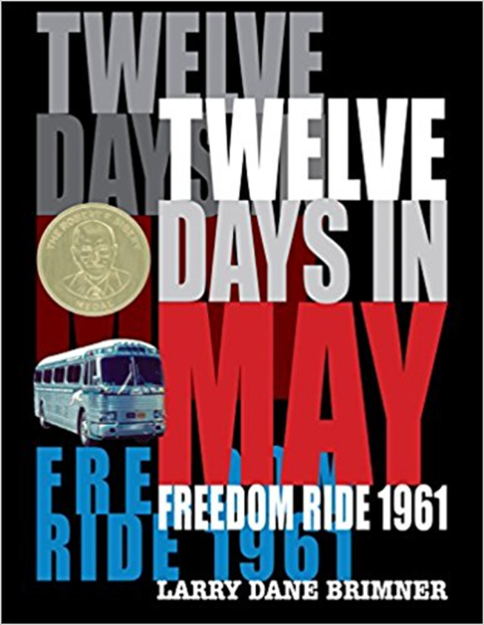
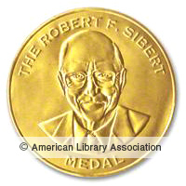
Twelve days in May: Freedom Ride 1961
By Larry Dane Brimner
On May 4, 1961, a group of thirteen black and white civil rights activists launched the Freedom Ride, aiming to challenge the practice of segregation on buses and at bus terminal facilities in the South. The Ride would last twelve days. Despite the fact that segregation on buses crossing state lines was ruled unconstitutional by the Supreme Court in 1946, and segregation in interstate transportation facilities was ruled unconstitutional in 1960, these rulings were routinely ignored in the South. The thirteen Freedom Riders intended to test the laws and draw attention to the lack of enforcement with their peaceful protest. As the Riders traveled deeper into the South, they encountered increasing violence and opposition. Noted civil rights author Larry Dane Brimner relies on archival documents and rarely seen images to tell the riveting story of the little-known first days of the Freedom Ride.

Slide 14
Battle of the Books
2018-2019
Start reading now!

